Slide 1
Confidence Interval and Confidence Level

Slide 2
Learning Objectives
After completion of today’s session you will be able to:
Explain confidence interval and confidence level.
Calculate the confidence interval for the regression line.

Slide 3
Agenda
Normal Distribution
Confidence Interval
Confidence interval calculation on regression line

Slide 4
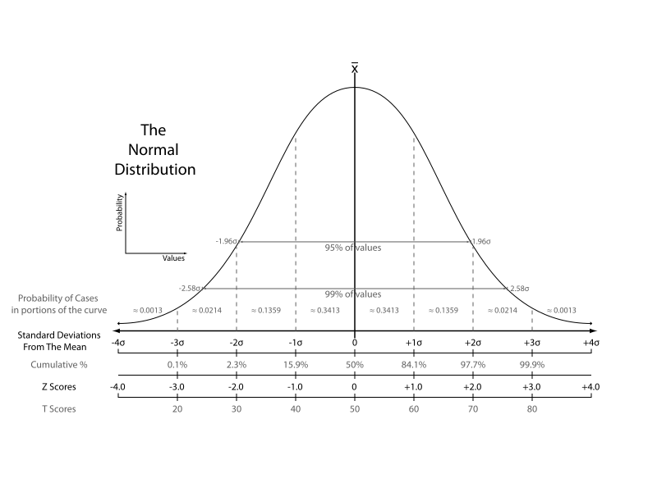
Normal distribution

Slide 5
Agenda
Normal Distribution
Confidence Interval
Confidence interval calculation on regression line

Slide 6
Confidence interval – idea
Suppose want to calculate the average age of students in the class.
  Sample mean age(from a random sample), x̄ = 20
Point estimate: It is a single value, statistic, computed from sample data, and used to estimate a population parameter.
Point estimate can’t really tell how good it represents a population, so we need some kind of interval to overcome this problem
  Example:
Point estimate of population mean μ

Slide 7
Confidence Level
It is the percentage of confidence intervals that we expect to contain the population parameter.
Often used confidence level are 90%, 95%(most common) and 99%.
Explanation:

Slide 8
Agenda
Normal Distribution
Confidence Interval
Confidence interval calculation on regression line

Slide 9
Statistical inference in regression
Multiple Regression Analysis
  Estimating Interval of predicted y
  Hypothesis Test for coefficients ( using T test)
  Hypothesis Test for the model overall ( using F test)

Slide 10
Assessing the Utility of the Model: Hypothesis tests
Test if a particular slope parameter is zero given that all other x's remain in the model: t –test.
Test if all of the slope parameters are zero: F –test.

Slide 11
Example
 | X | Y
 | 20 | 89.5
 | 14.8 | 79.9
 | 20.5 | 83.1
 | 12.5 | 56.9
 | 18 | 66.6
 | 14.3 | 82.5
 | 27.5 | 126
 | 16.5 | 79.3
 | 24.3 | 120
Mean | 18.7 | 87.1
(X_{i} –X) | (Y_{i} –Y)
1.29 | 2.39
-3.91 | -7.21
1.79 | -4.01
-6.21 | -30.21
-0.71 | -20.51
-4.41 | -4.61
8.79 | 39.19
-2.21 | -7.81
5.59 | 32.79
(X_{i} –X)(Yi –Y)
3.08
28.20
-7.18
187.64
14.59
20.34
344.43
17.27
183.25
(X_{i} –X)^2
1.66
15.30
3.20
38.58
0.51
19.46
77.24
4.89
31.24
Y_pred
92.42
70.99
94.48
61.51
84.18
68.93
123.34
78.00
110.15
(Y-Y_pred)^2 | (Y-Y_pred)^2
8.55 | 28.22
79.37 | 259.85
129.60 | 54.36
21.27 | 655.34
309.06 | 8.59
184.14 | 330.54
8.79 | 1312.19
1.70 | 83.05
95.14 | 530.62
837.60 | 3262.77
791.63 | 192.07
We want to compute
b1= Σ_{i} (X_{i} –X) (Y_{i} –Y )
Σ_{i} (X_{i} –X )²
b₀= Y-b₁ X
Y_pred=b₀+b₁ *X
b1= 4.12
b0= 9.99
SSE= | Σ(Y-Y_pred)^2
SSR= | Σ(Y-Y_pred)^2
SST= | SSE+SSR=
R2= | 1-SSE/SST =
837.60
3262.77
4100.37
0.795

Slide 12
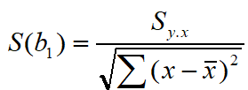
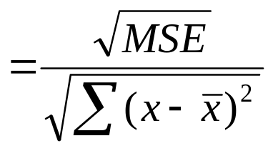
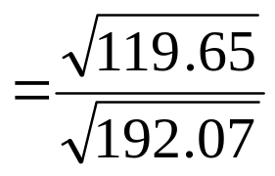
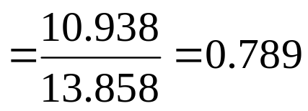
F and T test statistics
MSE=SSE/df1 = SSE/(n-k)= 837.6/(9-2)=119.65
MSR= SSR/df2 = SSR/(k-1)= 3262.77/1=3262.77
F value=MSR/MSE =3262.77 / 119.65= 27.26
Note: df: degree of freedom, n= #variables, k= #parameters
T (test statistic)= b1/s(b1) = 4.12/ 0.789 = 5.22

Slide 13
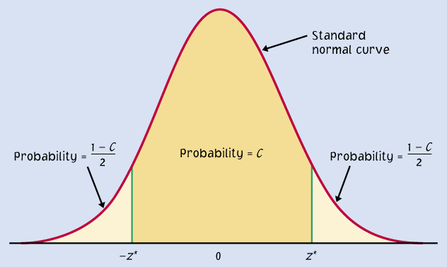
Estimating Interval
How do we predict the confidence interval of y (on different input sample) (Given x= 20 , sample size: n=9 in previous example)
On changing the sample X, the parameter b₁ may change in y =b₀+b₁x
A confidence interval can be expressed as: y ± m, m is called the margin of error
Where m= t_{critical} s_{b1} / √n
  Standard deviation in b1= s_{b1} = 0.789
t _{critical}= t_{(n - p, α/2 )} = t_{(9- 2, 0.025 )} = 2.365
Degree of freedom= n-p = 9-2=7 ,
(# variable-# parameter)
Confidence level=95%
significance level (α )=1- C=0.05
The Estimate is: y =b₀+b₁x
= 9.99+4.12*20 = 92.39
Df=7
=0.95
=0.025
A confidence level C (in %) indicates the likelihood of the population parameter that produces the interval.
t_{critical}=2.365
  So, the conf interval is
  y ± t_{(9- 2, 0.025 )} s_{ε} / √n =
  92.39 ± 2.365*0.789/3 .
  =92.39 ± 0.62

Slide 14
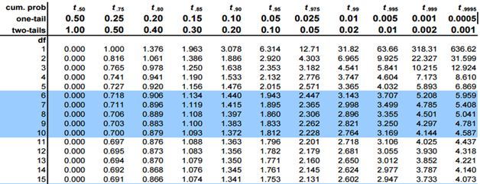
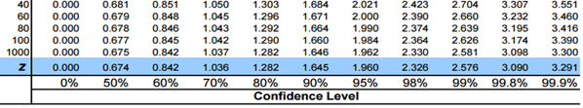

Slide 15
References
[1] https://statisticsbyjim.com/regression/interpret-f-test-overall-significance-regression/

Slide 16


